Slide 1
Virtualization Introduction

Slide 2
Moore’s law
Intel co-founder Gordon Moore is a visionary. His prediction, popularly known as Moore's Law, states that the number of transistors on a chip will double about every two years. Intel and other semiconductor companies kept that pace for over 40 years.
GPU’s performance and functionality have been increasing at a faster pace than Moore’s law.

Slide 3
Technology Advances
Multi-core: how to fully harness the power of multi-core? Intel has been trying really hard to make us all program for multi-core!!!
Large scale data: How to manage large scale data? Google, Yahoo, NSF and CRA have been promoting their file systems and MapReduce!!
Parallel processing of data: How to configure clusters to process data in parallel?
Answer: Virtualization

Slide 4
What is Virtulaization?
Virtualization is creation of an alternative to actual version of something:
virtual memory (more memory than physically available),
virtual time (buffering provides virtual/effective download time that less than the actual time),
Virtual hardware, desktop, disk, appliances, scenes,
Virtual worlds
In our context it is realizing one or more complete computer systems as guests on the base machine/operating system.
This offers an excellent conduit for delivering the vastly underutilized power of the multi-core and other resources such as storage and devices.

Slide 5
What is Virtualization?
To define it in a general sense,
virtualization encompasses any technology - either software or hardware - that adds an extra layer of isolation or extra flexibility to a standard system.
Familiar examples include
virtual memory for memory management,
virtual disks to allow for partitioning
"virtual machines" (e.g. for of Java and .net) to allow for better software portability.

Slide 6
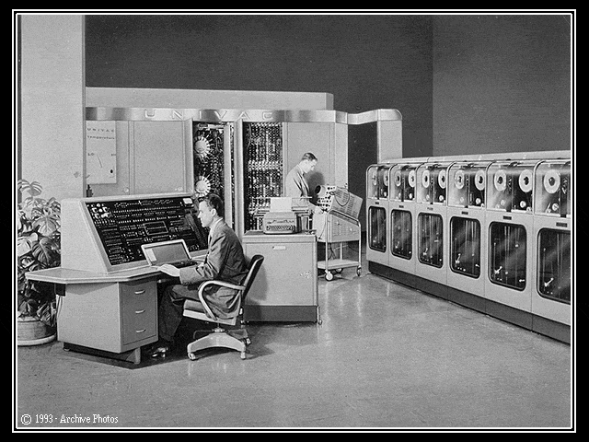
Virtualization History
Born from Mainframe Technology:
Originally part of mainframe technology, virtualization is not a new concept.
Mainframes started as very large computers in the 1960s to process compute tasks.

Slide 7
Virtualization on a Mainframe
Mainframe Virtualization:
Concept was to split the computer into multiple virtual machines so different “tasks” can be run separately and independently on the same mainframe.
If one virtual machine or “task” has a problem, other virtual machines are unaffected
VM #1
Task A
VM #2
Task B
VM #3
Task C
VM #4
Task D
VM #5
Task E
VM #6
Task F
VM #7
Task G
Mainframe Sample Diagram

Slide 8
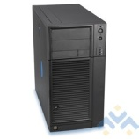
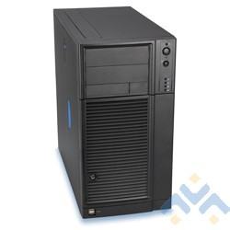
Computers in 1990s
Fast Forward to the 1990s
Intel/AMD servers now very popular (known as “x86” servers)
Each server runs Operating Systems such as Microsoft, Linux, or Netware
Companies put ONE operating system & ONE application on each server
2 servers would grow to 6 servers, eventually to 50 or more servers!
Electricity and space (footprint) becomes a problem….
File
Server
File
Server
File
Server
Web
Server
Web
Server
Domain
Server
DNS
Server
App
Server
Each Server Running
1 Application

Slide 9
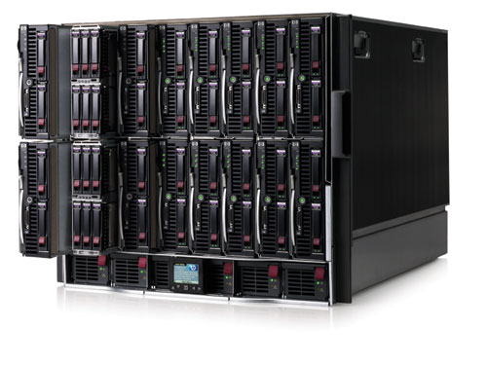
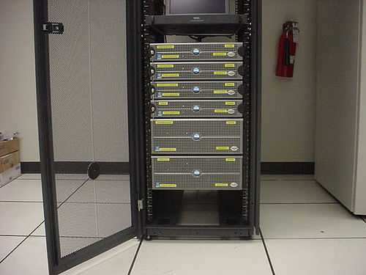
Computers in 2000s
Fast Forward to the 2000s
Manufacturers “to the rescue”!
Focus on making servers small
“Rack” form factors (6-20 servers per cabinet)
“Blade” form factors (30-60 servers per cabinet)
Space/footprint problem helped….some
Electricity and heat still a problem
As Servers Got Faster…
Server utilization became even lower
Average server utilization ranges between 4 -10%
STILL one application per server
Example HP “Blade” Servers
Example Dell “Rack” Servers

Slide 10

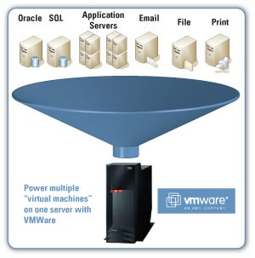
Virtualization is the Key
Apply Mainframe Virtualization Concepts to Intel / AMD Servers:
Use virtualization software to partition an Intel / AMD server to work with several operating system and application “instances”
Oracle
SQL
Application Servers
Email
File
Print
DNS
Domain
Deploy several “virtual machines”
on one server using groundbreaking virtualization software

Slide 11
Traditional Physical Server
Traditional x86 Server Architecture
Single operating system per machine
Single application per machine
Hardware components connected directly to operating system
CPU
Memory
Disk
Network Card
Application
Operating System
x86 Architecture
CPU
Memory
Disk
Network
1 Physical Server, 1 Application

Slide 12
New Architecture: Virtual Server
Virtualization Layer
Addition of a virtualization layer called a “hypervisor”
Several servers can be deployed as Virtual Machines (VM) on each physical box
Each VM has its own operating system and application
Can run multiple, different operating systems on the same machine
If one VM fails, other VMs are unaffected
Application
Application
Application
Microsoft
OS
Linux
OS
Microsoft
OS
CPU (s)
vDisk
CPU (s)
vDisk
CPU (s)
vDisk
Memory
vLAN
Memory
vLAN
Memory
vLAN
Virtualization Layer (Hypervisor)
x86 Architecture
CPU
Memory
Disk
Network
3 Virtual Servers on 1 Physical Server

Slide 13
Virtualization Layer Explored
Virtualization Layer - Compatibility
A virtual machine is compatible with standard x86 operating systems such as Windows and Linux
A virtual machine has a motherboard, cpu, memory, disk and network just like a physical server
Applications developed for the standard OS’s will work on a virtual machine
No adjustments are needed to run applications on virtual servers
Virtualization Layer - Isolation
Virtual machines on the same physical machine run independently
They are protected from each other

Slide 14
What is Hypervisor?
“Hypervisor is a software layer sits between Hardware and OSes which will interact with hardware and resources and provide an interface to share the available resources to Virtual containers.”

Slide 15
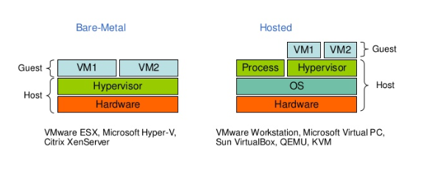
Hypervisor-based virtualization
Technologies that fall into this category can be divided into two basic types:
Type 1 (or native, bare-metal) hypervisors
are software systems that run directly on the host's hardware to control the hardware and to monitor guest operating-systems.
A guest operating system thus runs on another level above the hypervisor .
Type 2 (or hosted) hypervisors
are software applications running within a conventional operating-system environment.
Guest operating systems thus run at the third level above the hardware.

Slide 16
OS virtualization
Instead of simulating an entire set of hardware, the existing OS is "partitioned" to cater to several isolated applications that are all operating under the impression that they have sole control of the OS.
Though this remains restricted to the use of one kernel, the partitions can use different distributions and/or drivers and run completely independently.

Slide 17
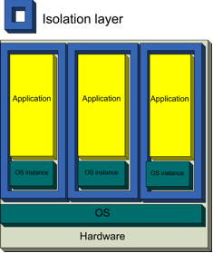
OS virtualization
Advantage : the amount of overhead created on the host system is greatly reduced compared to hardware virtualization, as there is no need to maintain a complete set of hardware for each partition.
Examples :
Linux-based systems: OpenVZ

Slide 18
OS virtualization
Every partition has its own network address and its own set of login credentials, system processes and daemon services.
Because the underlying operating system is always running, each partition can be rebooted independently and data can be migrated from one virtual environment to another on a live host.

Slide 19
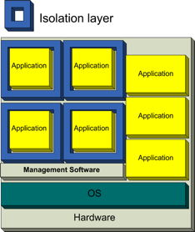
Application virtualization
Applications are turned into isolated, self-contained packages that are able to operate under an OS and use all of its resources.
Because the packages are basically a complete environment they no longer require installation, thus providing extremely easy software distribution along with the safety of a completely isolated application.
Examples : the Common Language Runtime environment of the .NET Framework and the Java Virtual Machine.

Slide 20
Virtual Machines Explored
Virtual Machines
A virtual machine is a collection of software that has been translated into files
These files are collected and organized in “containers”
These containers can be moved in seconds from one physical machine to another in case of physical server failure or performance needs.
Virtual machines have all the same hardware resources available such as CPU, memory, disk, and network

Slide 21
Virtualization Benefits
Consolidation
Redundancy
Legacy hardware
Migration
Centralized management

Slide 22
Docker Introduction

Slide 23
Agenda
What is Docker?
Docker vs. Virtual Machine
History, Status, Run Platforms
Hello World
Images and Containers
Volume Mounting, Port Publishing, Linking
Around Docker, Docker Use Cases
Hands-On Workshop

Slide 24
What is Docker?
Docker is an open-source project that automates the deployment of applications inside software containers, by providing an additional layer of abstraction and automation of operating system–level virtualization on Linux. [Source: en.wikipedia.org]

Slide 25
Market View: Evolution of IT
1995
2015
Thick, client-server app on thick client
Thin app on mobile, tablet
Well-defined stack:
O/S
Runtime
Middleware
Assembled by developers using best available services
Running on any available set of physical resources (public/private/ virtualized)
Monolithic Physical Infrastructure

Slide 26
Challenges
2015
Thin app on mobile, tablet
Assembled by developers using best available services
How to ensure services interact
consistently, avoid dependency hell
How to avoid n X n different configs
Running on any available set of physical resources (public/private/ virtualized)
How to migrate & scale quickly, ensure compatibility

Slide 27








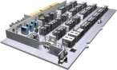


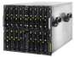

The Challenge
User DB
postgresql + pgv8 + v8
Do services and apps
interact appropriately?
Multiplicity of Stacks
Analytics DB
hadoop + hive + thrift + OpenJDK
Static website
nginx 1.5 + modsecurity + openssl + bootstrap 2
Queue
Redis + redis-sentinel
Background workers
Python 3.0 + celery + pyredis + libcurl + ffmpeg + libopencv + nodejs + phantomjs
Web frontend
Ruby + Rails + sass + Unicorn
API endpoint
Python 2.7 + Flask + pyredis + celery + psycopg + postgresql-client
Production Cluster
Multiplicity of
hardware environments
Development VM
Public Cloud
Can I migrate
smoothly and quickly?
QA server
Disaster recovery
Customer Data Center
Contributor’s laptop
Production Servers

Slide 28







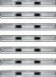
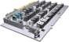

Results in N X N compatibility nightmare
Static website | ? | ? | ? | ? | ? | ? | ?
Web frontend | ? | ? | ? | ? | ? | ? | ?
Background workers | ? | ? | ? | ? | ? | ? | ?
User DB | ? | ? | ? | ? | ? | ? | ?
Analytics DB | ? | ? | ? | ? | ? | ? | ?
Queue | ? | ? | ? | ? | ? | ? | ?
 | Development VM | QA Server | Single Prod Server | Onsite Cluster | Public Cloud | Contributor’s laptop | Customer Servers

Slide 29
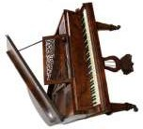


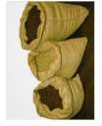
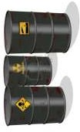

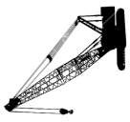


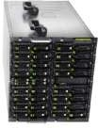
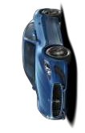
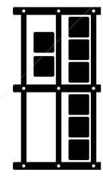

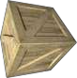
The Analogy
Do I worry about how goods interact (e.g. coffee beans next to spices)
Multiplicity of Goods
Can I transport quickly and smoothly
(e.g. from boat to train to truck)
Multiplicity of
methods for
transporting/storing

Slide 30
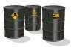
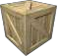



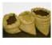

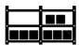
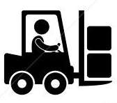
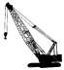



Also an NxN Matrix
? | ? | ? | ? | ? | ? | ?
? | ? | ? | ? | ? | ? | ?
? | ? | ? | ? | ? | ? | ?
? | ? | ? | ? | ? | ? | ?
? | ? | ? | ? | ? | ? | ?
? | ? | ? | ? | ? | ? | ?

Slide 31
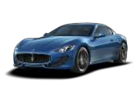
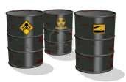

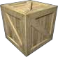
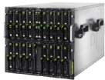

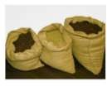
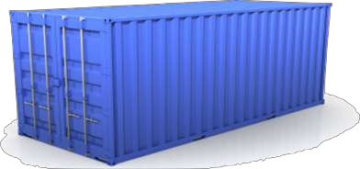
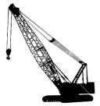
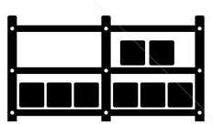




Solution: Intermodal Shipping Container
Multiplicity of Goods
Do I worry about
how goods interact (e.g. coffee beans next to spices)
A standard container that is loaded with virtually any goods, and stays sealed until it reaches final delivery.
…in between, can be loaded and unloaded, stacked, transported efficiently over long distances, and transferred from one mode of transport to another
Multiplicity of
methods for transporting/storing
Can I transport
quickly and smoothly (e.g. from boat to train to truck)

Slide 32
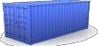
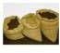
This eliminated the NXN problem…

Slide 33
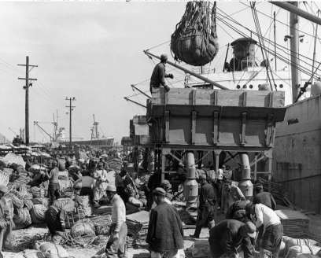
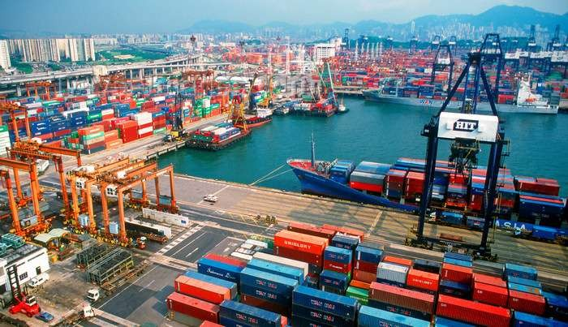
and spawned an Intermodal Shipping Container Ecosystem
90% of all cargo now shipped in a standard container
Order of magnitude reduction in cost and time to load and unload ships
Massive reduction in losses due to theft or damage
Huge reduction in freight cost as percent of final goods (from >25% to <3%)
→ massive globalizations
5000 ships deliver 200M containers per year

Slide 34





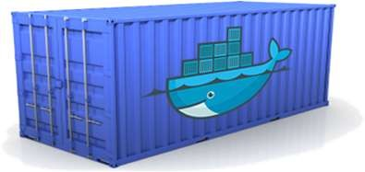
Docker is a shipping container system for code
Static website
User DB Web frontend Queue
Analytics DB
Do services and apps
interact appropriately?
Multiplicity of Stacks
An engine that enables any payload to be encapsulated as a lightweight, portable, self- sufficient container…
…that can be manipulated using standard operations and run consistently on virtually any hardware platform
Multiplicity of
hardware environments
Can I migrate
smoothly and quickly
Development VM
QA server
Customer Data Center
Public Cloud
Production Cluster
Contributor’s laptop

Slide 35
Or…put more simply
Static website
User DB
Web frontend
Queue
Analytics DB
Do services and apps
interact appropriately?
Multiplicity of Stacks
Developer: Build Once, Run
Anywhere (Finally)
Operator: Configure Once, Run on
Anything
Multiplicity of
hardware environments
Can I migrate
smoothly and quickly
Development VM
QA server
Customer Data Center
Public Cloud
Production Cluster
Contributor’s laptop

Slide 36

Docker solves the NXN problem
Static website
Web frontend
Background workers
User DB
Analytics DB
Queue
 | Development VM | QA Server | Single Prod Server | Onsite Cluster | Public Cloud | Contributor’s laptop | Customer Servers

Slide 37
What is Docker?
Docker is an open-source project that automates the deployment of applications inside software containers, by providing an additional layer of abstraction and automation of operating system–level virtualization on Linux. [Source: en.wikipedia.org]

Slide 38
Why containers matter
 | Physical Containers | Docker
Content Agnostic | The same container can hold almost any type of cargo | Can encapsulate any payload and its dependencies
Hardware Agnostic | Standard shape and interface allow same container to move from ship to train to semi-truck to warehouse to crane without being modified or opened | Using operating system primitives (e.g. LXC) can run consistently on virtually any hardware—VMs, bare metal, openstack, public IAAS, etc.—without modification
Content Isolation and Interaction | No worry about anvils crushing bananas. Containers can be stacked and shipped together | Resource, network, and content isolation. Avoids dependency hell
Automation | Standard interfaces make it easy to automate loading, unloading, moving, etc. | Standard operations to run, start, stop, commit, search, etc. Perfect for devops: CI, CD, autoscaling, hybrid clouds
Highly efficient | No opening or modification, quick to move between waypoints | Lightweight, virtually no perf or start-up penalty, quick to move and manipulate
Separation of duties | Shipper worries about inside of box, carrier worries about outside of box | Developer worries about code. Ops worries about infrastructure.

Slide 39
Why Developers Care
Build once…run anywhere
A clean, safe, hygienic and portable runtime environment for your app.
No worries about missing dependencies, packages and other pain points during subsequent deployments.
Run each app in its own isolated container, so you can run various versions of libraries and other dependencies for each app without worrying
Automate testing, integration, packaging…anything you can script
Reduce/eliminate concerns about compatibility on different platforms, either your own or your customers.
Cheap, zero-penalty containers to deploy services? A VM without the overhead of a VM?
Instant replay and reset of image snapshots? That’s the power of Docker

Slide 40
Why Devops Cares?
Configure once…run anything
Make the entire lifecycle more efficient, consistent, and repeatable
Increase the quality of code produced by developers.
Eliminate inconsistencies between development, test, production, and customer environments
Support segregation of duties
Significantly improves the speed and reliability of continuous deployment and continuous integration systems
Because the containers are so lightweight, address significant performance, costs, deployment, and portability issues normally associated with VMs

Slide 41
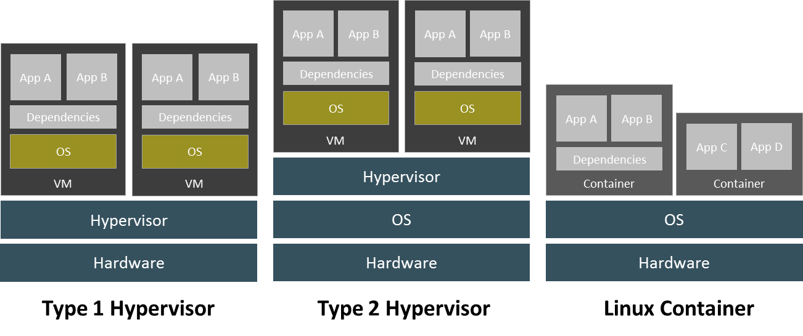
Virtualization Technologies
Containers are lightweight:
share the host OS kernel
share the host OS root file system wherever appropriate
Notes:
Type 1 hypervisors run directly on the “bare metal” hardware and do not require a host operating system to run virtual machines.
Type 2 hypervisors allow users to run virtual machines on top of an existing operating system.
Type 2 hypervisors are popular because they allow the user the run new guests on an existing operating system.
Type 1 hypervisors are lean and provide higher performance, availability, and security.
Linux Containers fill the gap between type 1 and type 2 hypervisors.
They run on top of an existing operating system, are lightweight by removing duplication of system libraries and the kernel, and provide high performance.
A Container is a set of processes, running on top of a common kernel.
These processes are isolated from the rest of the machine.
They cannot see/affect/harm the host or other containers.
They use Linux namespaces to have a private view of the system (network interfaces, PID tree, mountpoints).
They use cgroups to support metered/limited/reserved resources.

Slide 42
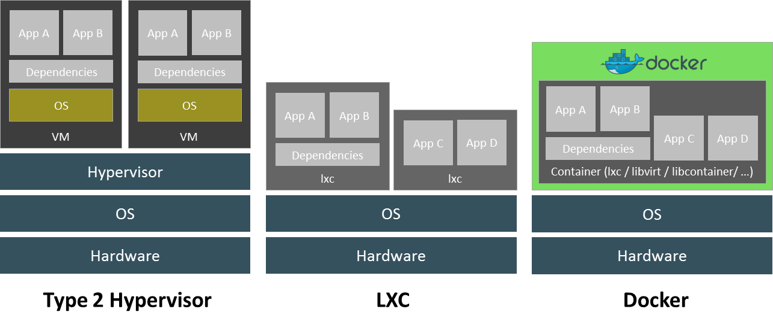
Virtualization Technologies
Docker provides a unified access to
Linux container technology (cgroups, namespaces)
Various container implementations (lxc, libvirt, libcontainer, etc.)
‘libcontainer’ is Docker’s implementation of container technology
Notes:
Docker is not a replacement for LXC.
Docker offers a high-level tool with several powerful functionalities:
Portable deployment across machines.
Application-centric. Docker is optimized for the deployment of
applications, as opposed to machines.
Automatic build. Docker includes a tool for developers to
automatically assemble a container from their source code, with full
control over application dependencies, build tools, packaging etc.
Versioning. Docker includes git-like capabilities for tracking successive
versions of a container, inspecting the diff between versions,
committing new versions, rolling back, etc.
Component re-use. Any container can be used as an "base image" to create more specialized components.
Sharing. Docker has access to a public registry (http://index.docker.io) where thousands of people have uploaded useful containers: anything
from redis, couchdb, postgres to irc bouncers to rails app servers to hadoop to base images for various distros.
Tool ecosystem. Docker defines an API for automating and customizing the creation and deployment of containers. There are a huge number
of tools integrating with Docker to extend its capabilities.

Slide 43
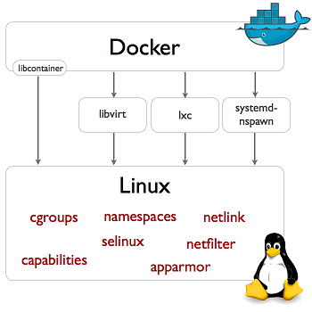
Virtualization Technologies
Docker – Underlying Technology
Notes:
Docker makes use of several Linux kernel features to deliver the functionality.
Libcontainer enables Docker containers to work with Linux namespaces, control groups, capabilities, AppArmor security profiles,
network interfaces and firewalling rules in a consistent and predictable way.
Libcontainer is part of the Docker project, and is the default implementation for Docker contatiners.
Docker provides an API that allows any container engine to be used (libvirt, lxc, systemd-nspawn).

Slide 44
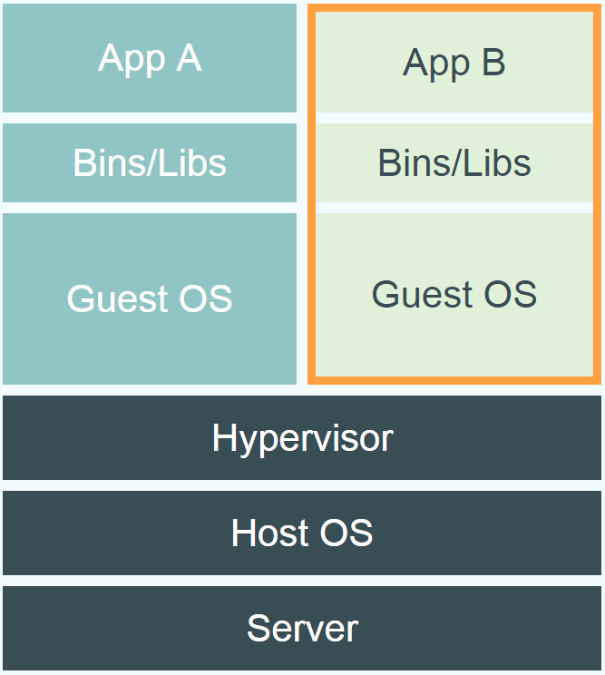
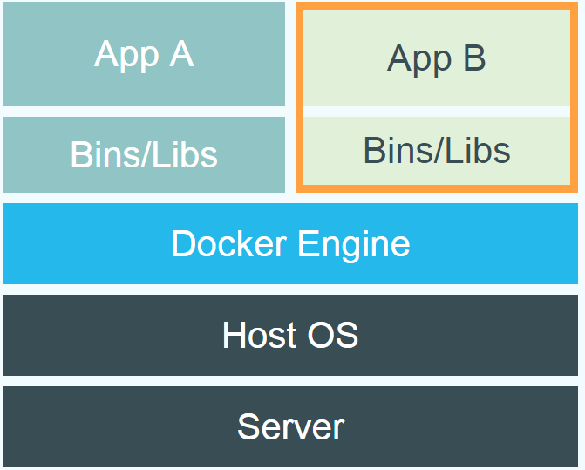
Docker vs. Virtual Machine
Source: https://www.docker.com/whatisdocker/
Notes:
Virtual Machines
Each virtualized application includes not only the application - which may be only 10s of MB - and the necessary binaries and libraries, but also an entire guest operating system - which may weigh 10s of GB.
Docker
The Docker Engine container comprises just the application and its dependencies. It runs as an isolated process in userspace on the host operating system, sharing the kernel with other containers. Thus, it enjoys the resource isolation and allocation benefits of VMs but is much more portable and efficient.
Docker provides base images that contain OS installations we can start from: The OS is not more than an application running on the Kernel...

Slide 45
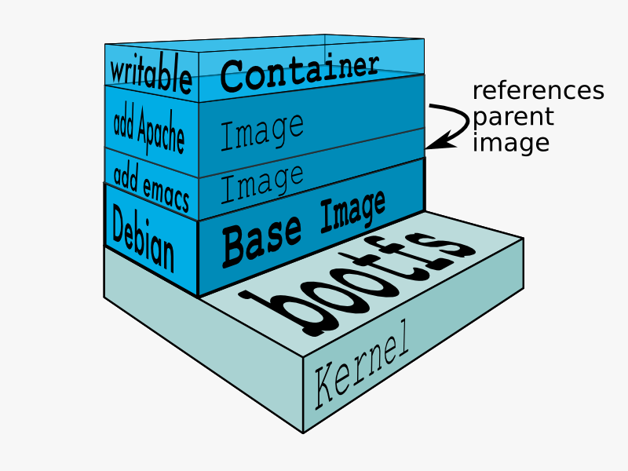
Docker Technology
libvirt: Platform Virtualization
LXC (LinuX Containers): Multiple isolated Linux systems (containers) on a single host
Layered File System
[Source: https://docs.docker.com/terms/layer/]

Slide 46
What are the basics of the Docker system?
Docker Container Image Registry
Image A
Push
Search
Pull
Run
Build
Dockerfile For
A
Docker Engine
Image A
Container A1
Container A2
Source Code Repository
Docker Engine
Host 1 OS (Linux)
Host 2 OS 2 (Linux)

Slide 47
Changes and Updates
App A
Build & Push
App Δ
Docker Container Image Registry
Bins/ Libs
Base Container Image
Container
Mod A’
Container
Mod A’’
App Δ
Update
App A’’
Bins/ Libs
Docker Engine
App A
Bins/ Libs
Docker Engine
Host running A wants to upgrade to A’’. Requests update. Gets only diffs
Host is now running A’’

Slide 48
Run Platforms
Various Linux distributions (Ubuntu, Fedora, RHEL, Centos, openSUSE, ...)
Cloud (Amazon EC2, Google Compute Engine, Rackspace)
2020: Microsoft announces plans to integrate Docker with next release of Windows Server

Slide 49
Hello World
Simple Command - Ad-Hoc Container
docker run ubuntu echo Hello World
docker images [-a]
docker ps –a
Notes:
Immediately exits
docker ps
docker ps –a
Re-attach: docker start –i stoic_wozniak
docker commit –m «message» containerId imageName(e.g. mytest/test1:1.0)
New Image
docker images

Slide 50
Terminology – Image
Persisted snapshot that can be run
images: List all local images
run: Create a container from an image and execute a command in it
tag: Tag an image
pull: Download image from repository
rmi: Delete a local image
This will also remove intermediate images if no longer used

Slide 51
Terminology - Container
Runnable instance of an image
ps: List all running containers
ps –a: List all containers (incl. stopped)
top: Display processes of a container
start: Start a stopped container
stop: Stop a running container
pause: Pause all processes within a container
rm: Delete a container
commit: Create an image from a container
Notes:
docker run --rm to remove container after termination

Slide 52
Docker Architecture

Slide 53
Image vs. Container
Base Image
ubuntu:latest
run
Container
cid1
base image
cmd → new state
New Image
iid1
commit
Container
cid1
run
Container
cid2
Container
cid3
Container
cid4

Slide 54
Docker File
Create images automatically using a build script: «Dockerfile»
Can be versioned in a version control system like Git or SVN, along with all dependencies
Docker Hub can automatically build images based on dockerfiles on Github

Slide 55
Dockerfile Example
Dockerfile:
FROM ubuntu ENV DOCK_MESSAGE Hello My World ADD dir /files CMD ["bash", "someScript"]
docker build [DockerFileDir]
docker inspect [imageId]
Notes:
docker run -ti d97 /bin/bash
testFile.txt -> present
set -> env Variable PROVIDER set
docker run –P -d d97

Slide 56
Mount Volumes
docker run –ti –v /hostLog:/log ubuntu
Run second container: Volume can be shared
docker run –ti --volumes-from firstContainerName ubuntu
Notes:
Use docker start, docker attach to reuse container
Change script to echo ... >> /log/hello3.log

Slide 57
Publish Port
docker run –t –p 8080:80 ubuntu nc –l 80
Map container port 80 to host port 8080
Check on host: nc localhost 8080
Link with other docker container
docker run -ti --link containerName:alias ubuntu
See link info with set
Notes:
Use ifconfig -> eht1 to access from host

Slide 58
Around Docker
Docker Images: Docker Hub
Vagrant: «Docker for VMs»
Automated Setup
Puppet, Chef, Ansible, ...
Docker Ecosystem
skydock / skydns
fig
Notes:
skydock / skydns: Docker discovery by lightweight DNS server
fig: fig.xml: discribe how to build or retrieve each service’s Docker image

Slide 59
Docker Hub
Public repository of Docker images
https://hub.docker.com/
docker search [term]
Automated: Has been automatically built from Dockerfile
Source for build is available on GitHub
Notes:
Automatically build a Docker image on Docker-Hub:
Example: playground-docker-echoey in Bitbucket: https://bitbucket.org/inftec/playground-docker-echoey/overview
Automated Build Repository on Docker Hub: https://registry.hub.docker.com/u/pazoozoo/playground-docker-echoey/
Build took around 5 minutes...
Run on AWS Elastic Beanstalk:
Need to ZIP Dockerfile and dependencies (ADD files)
Beanstalk environment expects HTTP service on first EXPOSEd port though → not working with dummy echo service

Slide 60
Docker Use Cases
Development Environment
Environments for Integration Tests
Quick evaluation of software
Microservices
Multi-Tenancy
Unified execution environment (dev → test → prod (local, VM, cloud, ...)

Slide 61
Docker Mind Map

Slide 62
Documentation
Docker homepage: https://www.docker.com/
Introduction: https://www.docker.com/whatisdocker/
Online tutorial: https://www.docker.com/tryit/
Installation and user guide: https://docs.docker.com/

Slide 63
PID, Namespaces and CGroups
PID: [Process ID]
Every process is uniquely identified in Unix with Process ID
Namespaces:
wraps a global system resource in an abstraction that makes it appear to the processes within the namespace that they have their own isolated instance of the global resource.
Namespaces provide processes with their own view of the system
CGroup:
Control Groups provide a mechanism for aggregating/partitioning sets of tasks, and all their future children, into hierarchical groups with specialized behaviour.
Cgroups involve resource metering and limiting:
memory
CPU
block I/O
network

Slide 64
Namespaces
lightweight process virtualization.
Isolation: Enable a process (or several processes) to have different views of the system than other processes.
Much like Zones in Solaris.
Only one system call was added (setns())
No hypervisor layer (as in OS virtualization like KVM, Xen)

Slide 65
Namespaces
There are currently 6 namespaces:
mnt (mount points, filesystems)
pid (processes)
net (network stack)
ipc (System V IPC)
uts (hostname) - Unix timesharing
user (UIDs)

Slide 66
How do we know if two processes are in the same namespace ?
Namespaces do not have names.
Six entries (inodes) were added under /proc/<pid>/ns (one for each namespace).
Each namespace has a unique inode number.
This inode number of a each namespace is created when the namespace is created.

Slide 67
CGroups
cgroups (control groups) subsystem is a Resource Management solution providing a generic process-grouping framework.
Namespaces provide per process resource isolation solution.
Cgroups provide resource management solution (handling groups).
Add procfs entries:
For each process: /proc/pid/cgroup.
System-wide: /proc/cgroups

Slide 68
In Short
Namespaces = limits what you [process] can see (and therefore use)
Cgroups = limits how much you [process] can use;

Slide 69
Docker Compose
Compose is a tool for defining and running multi-container Docker applications. With Compose, you use a YAML file to configure your application’s services. Then, with a single command, you create and start all the services from your configuration.
Using Compose is basically a three-step process:
Define your app’s environment with a Dockerfile so it can be reproduced anywhere.
Define the services that make up your app in docker-compose.yml so they can be run together in an isolated environment.
Run docker compose up

Slide 70
Example Compse.yaml
version: "3.9" # optional since v1.27.0
services:
web:
build: .
ports:
- "5000:5000"
volumes:
- .:/code
- logvolume01:/var/log
links:
- redis
redis:
mage: redis
volumes:
logvolume01: {}

Slide 71
Docker Compose
Compose has commands for managing the whole lifecycle of your application:
Start, stop, and rebuild services
View the status of running services
Stream the log output of running services
Run a one-off command on a service

Slide 72
Docker Swarm
Docker swarm is a container orchestration tool, meaning that it allows the user to manage multiple containers deployed across multiple host machines
One of the key benefits associated with the operation of a docker swarm is the high level of availability offered for applications. In a docker swarm, there are typically several worker nodes and at least one manager node that is responsible for handling the worker nodes' resources efficiently and ensuring that the cluster operates efficiently.
Docker Swarm has two types of services: replicated and global.
Replicated services: Swarm mode replicated services functions by you specifying a number of replica tasks for the swarm manager to assign to available nodes.
Global services: Global services function by using the swam manager to schedule one task to each available node that meets the services constraints and resource requirements.

